Slide 1
Artificial intelligence

Slide 2

Artificial Intelligence
DEFINITIONS
“the study of ideas that enable computers to be intelligent.”
"the study and design of intelligent agents"
Intelligence?

Slide 3
Artificial Intelligence
INTELLIGENCE
Definition
...ability to reason?
...ability to acquire and apply knowledge?
...ability to perceive and manipulate things?

Slide 4
Goals of AI
Make computers more useful
Understand the principles that make intelligence possible

Slide 5
Points of view
Strong AI: all mental activity is done by computing ( feelings and conscience can be obtained by simple computation )
Soft AI: mental activity can only be simulated
Opinions are not the same ethically speaking when treating intelligent beings or aparently intelligent beings

Slide 6
What makes AI a moral issue?
Rights (private life, anonimity)
Duties
Human welfare (physical safety)
Justice (equality)
Ethical problems resulting from AI and intelligent systems can be divided into 3 main sections
Information Control and Reasoning

Slide 7
What makes AI a moral issue?
1. Information and communication
Intelligent systems store information in databases. Massive management of information and communications between systems could threaten private life, liberty or dignity of users.

Slide 8
What makes AI a moral issue?
2. Control applications – Robotics
Common problems of classical engineering: guarantee personal safety (physical) and take responsibilities with the environment.
- Basic safety in robotics : universal laws stating rules about behavior between robots and human (robots cannot injure humans, robots must protect humans...)

Slide 9
What makes AI a moral issue?
3. Automatic reasoning
Idea: computers taking decisions by themselves
Problem: trust in intelligent systems
Examples:
- Medical diagnosis by symptoms
- Artificial vision
- Automatic Learning
- Natural language processing
New ethical problems !

Slide 10
Automatic Reasoning
Ethical problems
1. Computers have no consciousness
- They can not take responsibility of their actions
- Are the creators responsible? The company in charge?
- This way final decisions are always taken by humans
2. A consciounsness AI is developed
- Could a computer simulate animal or human brain in order to receive the same animal or human rights?
- Responsibilities

Slide 11
Consciousness AI
Definition:
Consciousness
“an alert cognitive state in which you are aware of yourself and your situation”
AI systems would not only get rights, but also they would want to have rights.

Slide 12
Consciousness AI
Trust: Automatic pilot VS. automatic judge, doctor or policeman
Equality problems: Could conscious computers work for us? Would not they become slaves? Do we have the right to turn off a conscious computer?

Slide 13
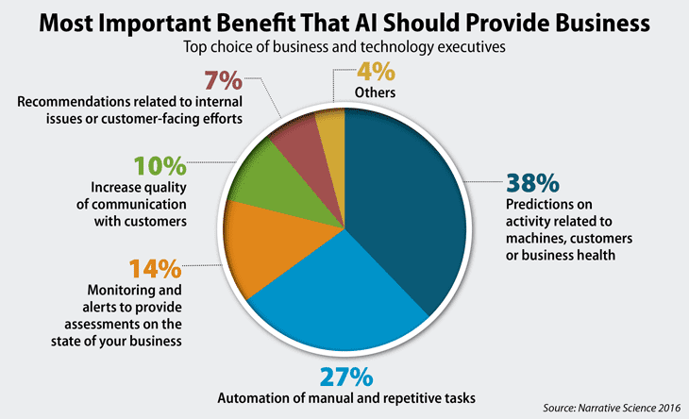
AI in Business

Slide 14
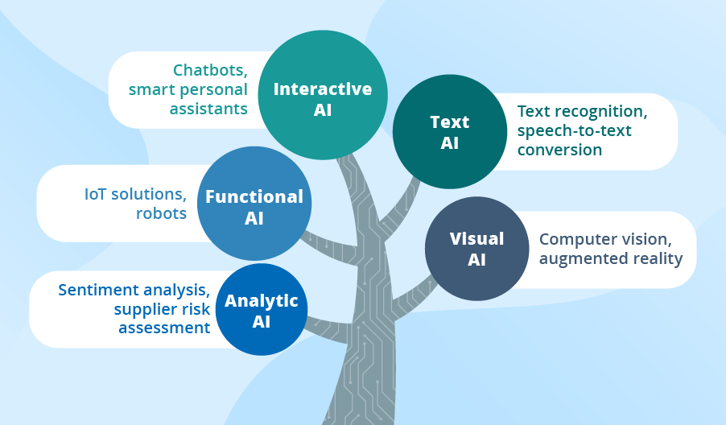
Examples of AI Applications in Businesses

Slide 15
AI Limits
AI depends on
Laws and economics
Technology
-Current technology is not enough, but is improving exponentially (Moore’s Law).
-Physical and theoretical bounds are too far to be a possible restriction
Ethics
-Should be the first obstacle to the evolution of AI

Slide 16
AI in the future
Education in AI ethics
Think about future goals of AI
Decisions taken will lead to new ethical problems
AI needs paralell evolution in biology, psychology...as well as technology

Slide 17
Conclusion
Current AI ethics are quite undefined
Everyday new controversial discussions are held around AI in the future
AI wants to create something we do not really know: intelligence
What is intelligence could be find out by AI researching
We can not think about AI without ethics

Slide 18

Questions

